Slide 1




DIGITAL LITERACY
SKILLS
BASIC USERS

Slide 2
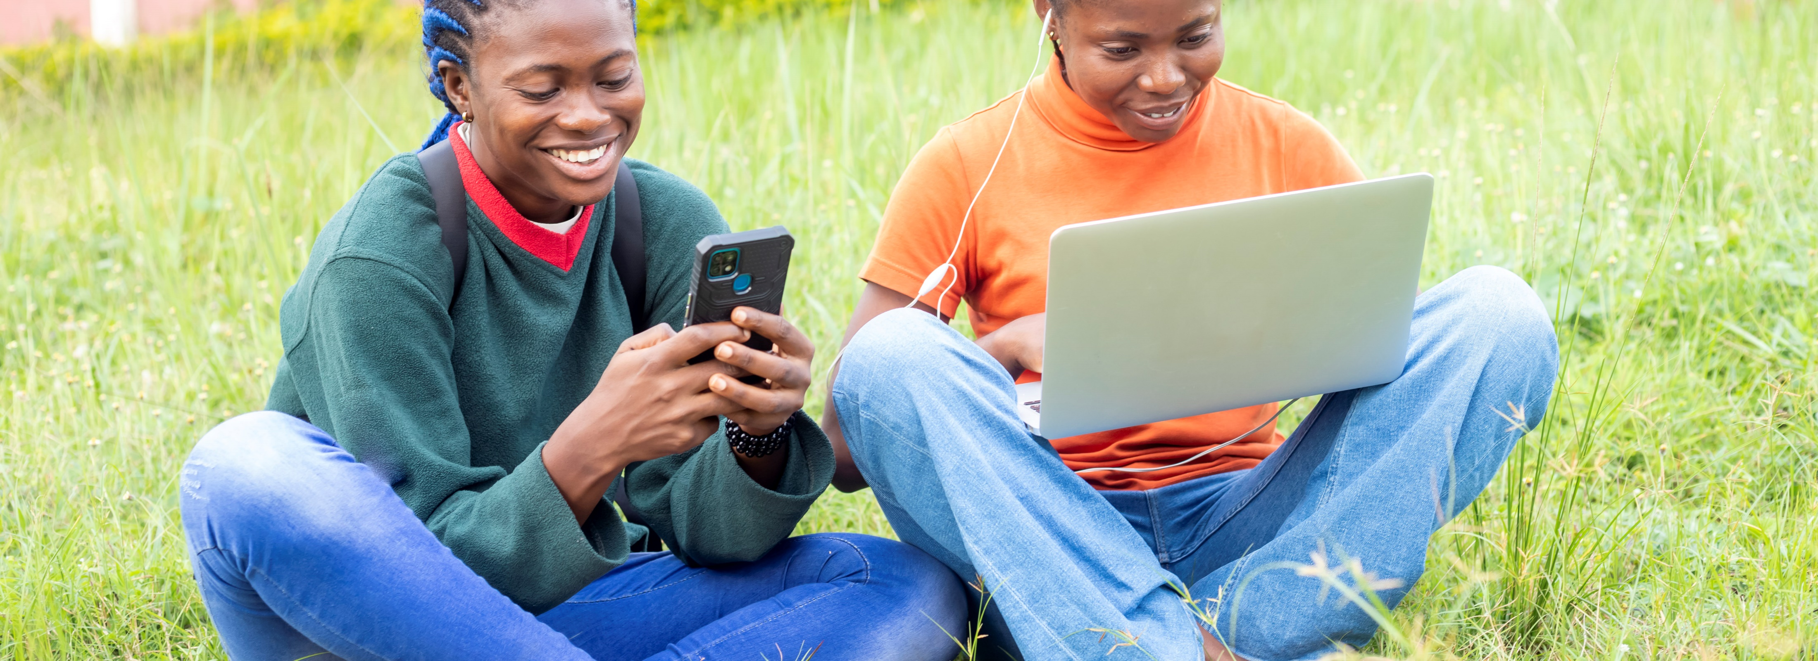
Module 5
Safety and security

Slide 3

3
Unit 3: Protecting health and well-being

Slide 4
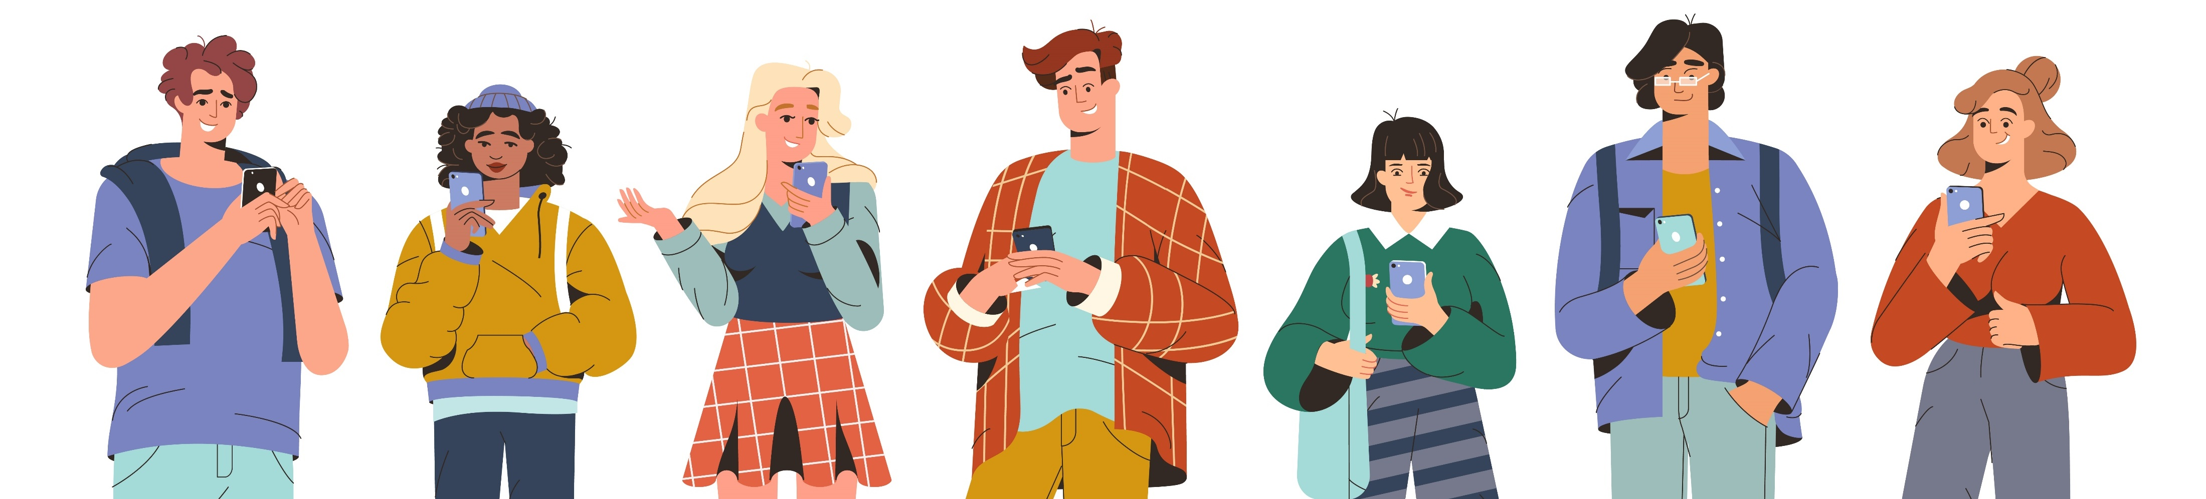
Negative effects of technology: what to know
Some forms of technology may have made positive changes in the world, there is also evidence for the negative effects of technology and its overuse.
Social media and mobile devices may lead to psychological and physical issues.

Slide 5
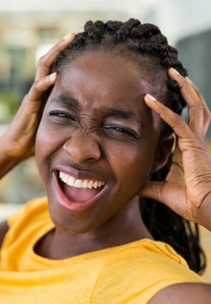
Physical health effects
Eyestrain
Using technologies for long periods may lead to eyestrain.
Symptoms of digital eyestrain can include blurred vision and dry eyes.
Eyestrain may also lead to pains in other areas of the body, such as the head, neck, or shoulders.

Slide 6
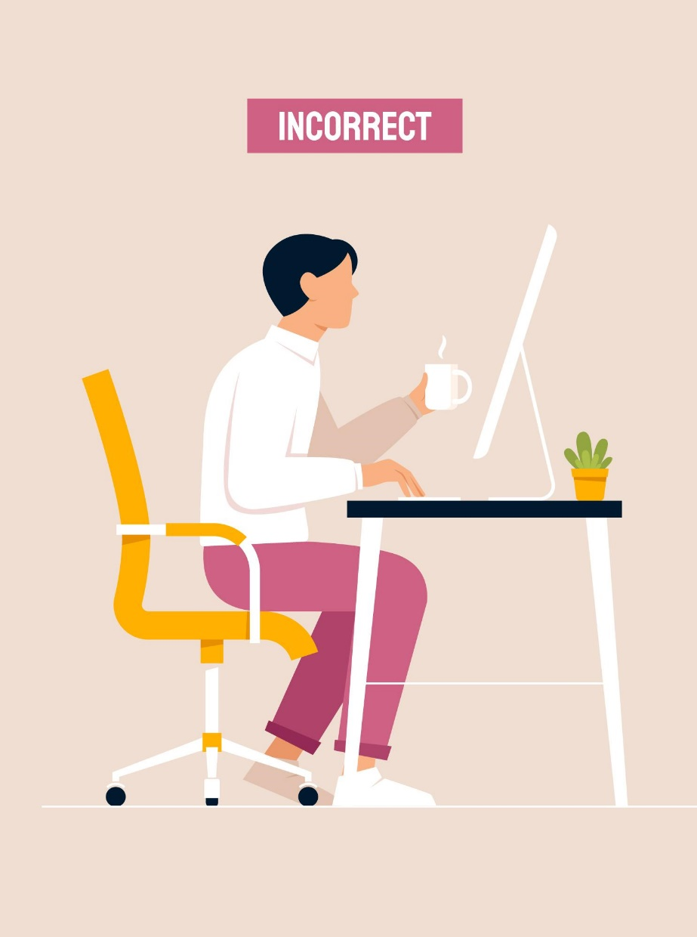
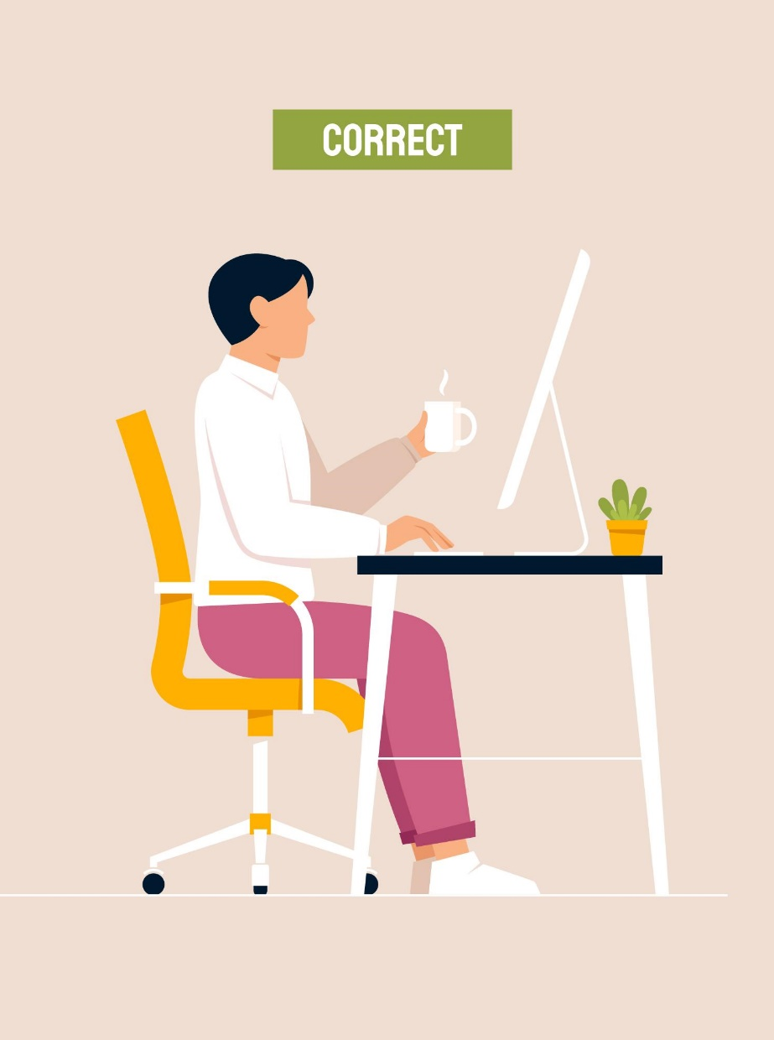
Physical health effects
Poor posture
Sleep problems
Reduced physical activity

Slide 7
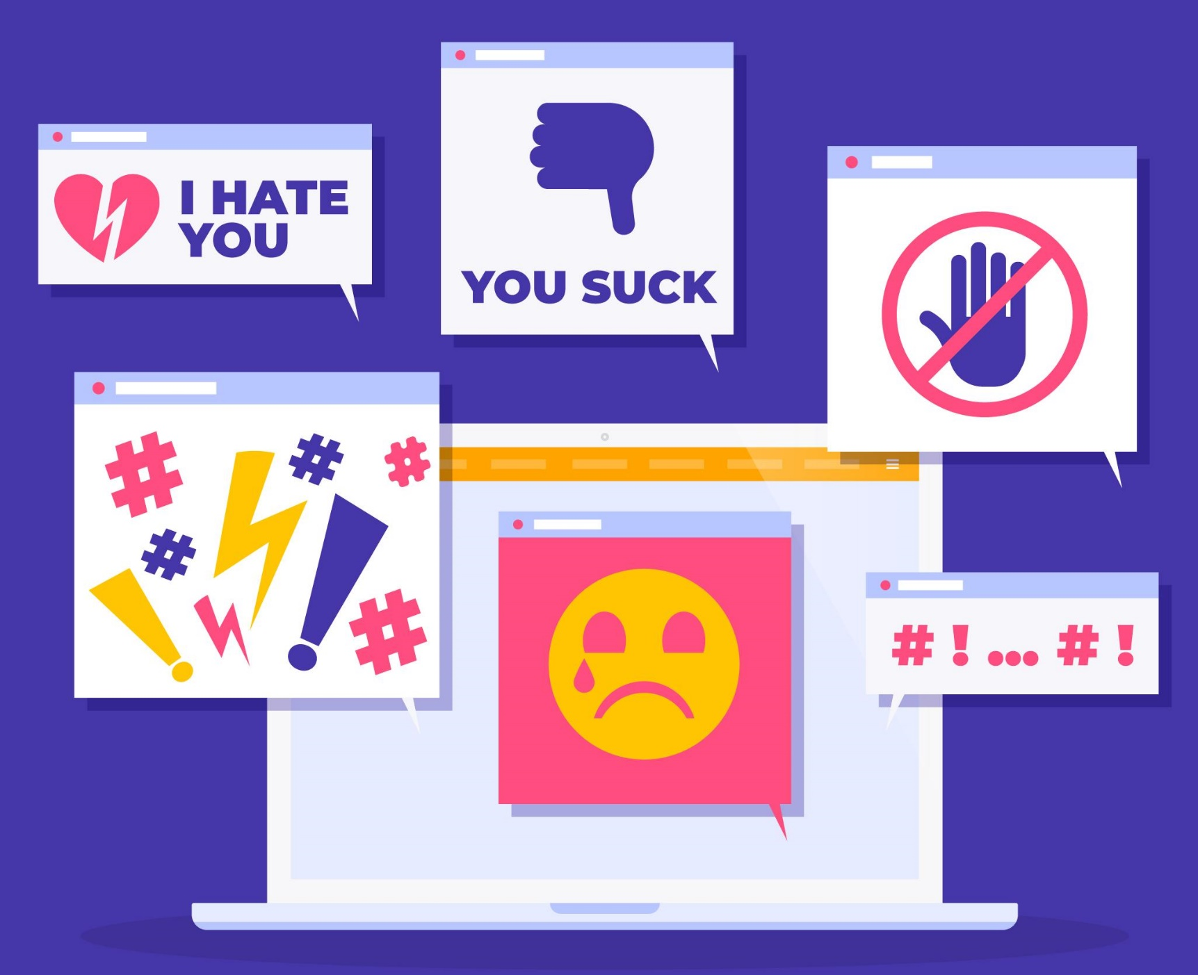
Cyberbullying
Cyberbullying is using technology to harass or bully someone else.
Devices offer bullies opportunities such as email, instant messaging, webpages, and digital photos.
Cyberbullying can range from cruel or embarrassing rumours to threats, harassment, or stalking.
It can affect any age group; however, teenagers and young adults are common victims, and cyberbullying is a growing problem in schools.

Slide 8

How can you protect yourself?
Learn good online habits.
Watch for warning signs in the language used online.
Limit availability of personal information.
If the situation escalates to cyberbullying, communicate this to someone who can help.
Avoid escalating the situation.
Document the activity. Keep a record of any online.
Report cyberbullying to the appropriate authorities..

Slide 9
Skills to practise
Protect your health
Examine where you are sitting and the position of your device.
Ask these questions:
Am I comfortable and can I sit like this without feeling any pain? Change your position so that you will remain comfortable.
Do you feel any eye strain? If so, change the position of the device.
Continue >

Slide 10
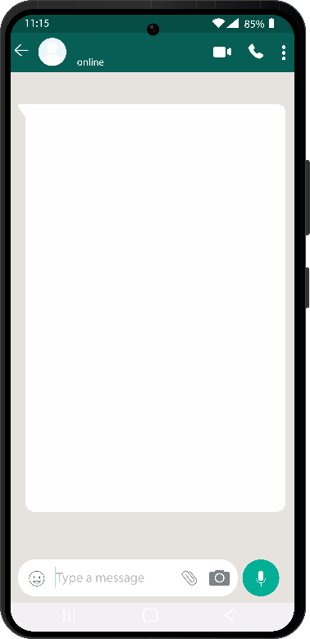
Skills to practise
2. Protect yourself and others
You or one of your friends receive the following message:
Think about how such a message will make you feel.
If you receive any message that is unkind, do not be tempted to reply. If you don’t know who sent the message, delete it. If you do know, report the incident to your facilitator.
If you receive it on social media – leave the group immediately and block the user. You may need to delete the social media app and change your profile.
Do the same to help a friend.
YOU ARE FAT AND UGLY!
NO ONE WILL EVERY LOVE YOU – THAT IS WHY YOU DON’T HAVE A GIRLFRIEND!
EVERYONE KNOWS!!

Slide 11
All back covers should include
contact information of the section
producing the work.
© United Nations Children’s Fund (UNICEF) [month and year of publication]

